Slide 1

Converting Casual to Annual Members (A google case study)
Hans Dano

Slide 2
Background Behind The Study:
PDF File: Case Study 1_How does a bike-shared navigate speedy success_.pdf
Data Source: Index of bucket "divvy-tripdata“ (Last 12 Months of Data)

Slide 3
The Business Task:
Determining difference between casual and annual members

Slide 4
Rides Per Week - Annual members make up ~63% (Peak of 600k+)

Slide 5
Rides Per Month

Slide 6
Business Task: Summary and Application
1. Prioritizing the right time for ad campaigns
2. Capitalize on the warmer seasons through different types of memberships

Slide 7
Further Study: Ride Types

Slide 8
Other things to consider, and a great future for the company!

Slide 9
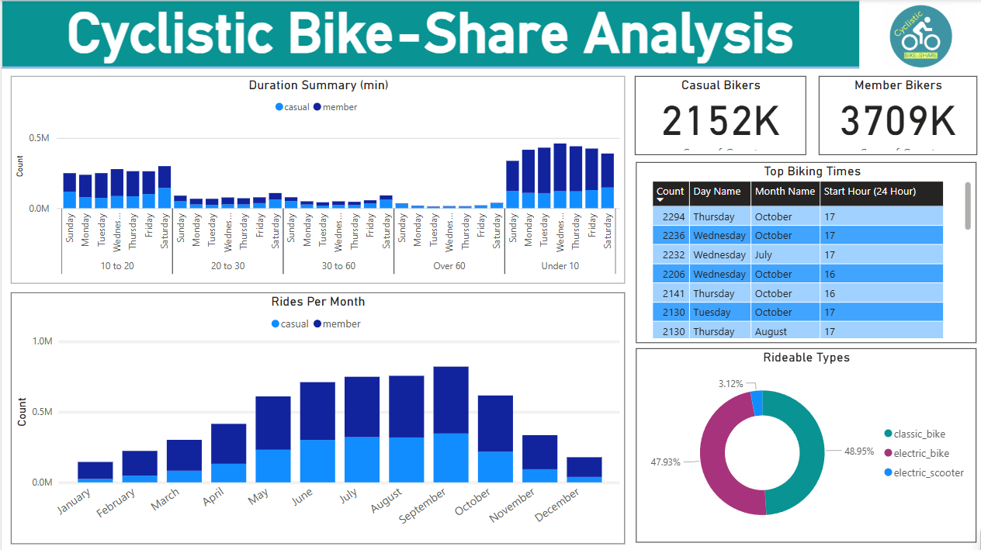
Power BI Dashboard & Thank you!
Bike Capstone Project -> Main -> Cyclistic _Bike_Share_Dashboard_2024

